Slide 1
Safety Reporting System (SRS) report
Jan 1st – Dec 31st 2018
Ibrahim Qoulaghasi
Quality Coordinator, QMD
King Faisal Specialist Hospital & Research Centre
Notes:
Key Points:
Unit-based safety programs promote safety culture.
According to the IOM, units/organizations with a positive safety hold these key beliefs:
Our processes are designed to prevent failure.
We are committed to detect and learn from error.
We have a just culture that disciplines based on risk.
People who work in teams make fewer errors
Source:
Institute of Medicine (IOM). Patient safety: Achieving a new standard of care. Washington, DC: The National Academies Press; 2004.

Slide 2
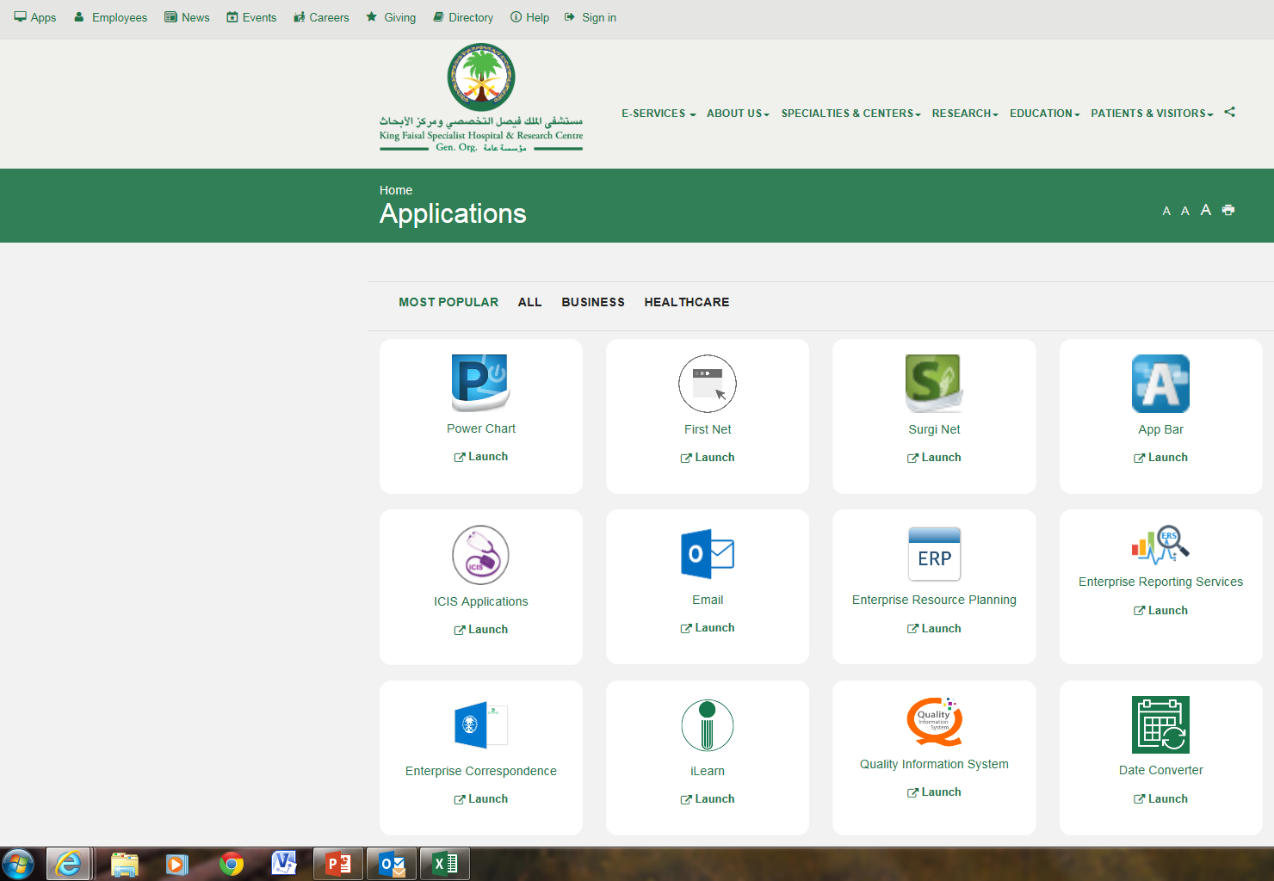
Notes:
How do we measure?
From Katherine Jones, PT, PhD

Slide 3
Notes:
How do we measure?
From Katherine Jones, PT, PhD

Slide 4
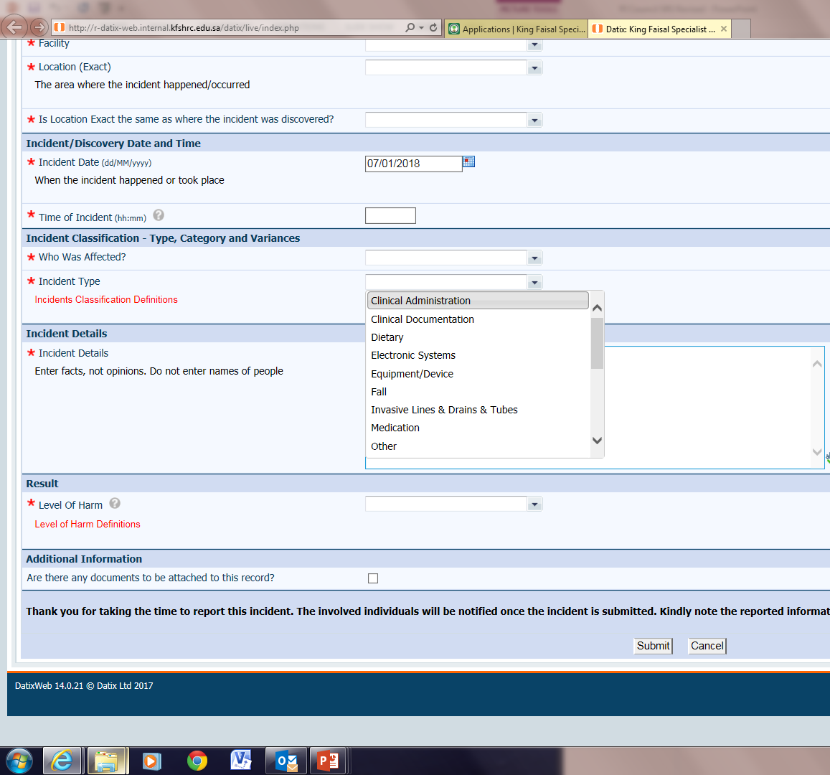
Incident Types Covered in SRS
Pressure Ulcers
Skin Integrity
Falls
Invasive Lines/Tubes
Patient Management
Procedural
Medication
Specimen
Transfusion Related
Trauma
Work Related Injuries
Dietary
Equipment/Device
Safety
Security
Electronic System
Clinical Administration
Clinical Documentation
Supplies/Consumables
Other
Notes:
How do we measure?
From Katherine Jones, PT, PhD

Slide 5
Number of Reported Incidents per Year
Notes:
1. Paper format 2002, 2. Qsatim implementation mid 2009, 3. Datix (QIS) implementation April 2014, 4. SRS training 101 started on Jan 2016, 5. Report one to prevent the next one campaign stated on Feb 2016, 6. Great catch program March 2017, 7. System redesign implemented on Oct 2017.

Slide 6
Number of Incidents by Months 2017 - 2018
Notes:
How do we measure?
From Katherine Jones, PT, PhD

Slide 7
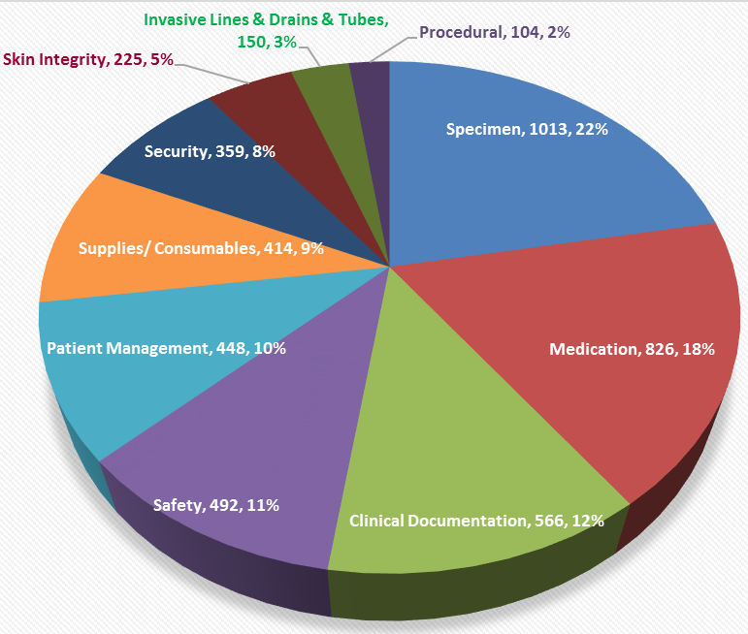
Top 10 Reported incident by Incident type FY 2018
2017
Notes:
How do we measure?
From Katherine Jones, PT, PhD

Slide 8
Top 10 Incidents by Location (Exact) FY 2018
Notes:
How do we measure?
From Katherine Jones, PT, PhD

Slide 9
DEM Drill Down Reported Incidents by Incident Type FY 2018

Slide 10
DEM Drill Down
By Specimen Stage FY 2018

Slide 11
DEM Drill Down
By Specimen Stage “collection” FY 2018

Slide 12
Clinical Documentation by Variances

Slide 13
Top 10 Clinical Documentation (Missing, Incomplete, Incorrect) per location Exact

Slide 14
Top 10 Patient Management by Sub Category

Slide 15
Top 10 Patient Management (Delay Treatment) per Location Exact

Slide 16
Top 10 Patient Management (Delay Admission) per Location Exact

Slide 17
Top 15 Incidents by Discover Location FY 2018
Notes:
How do we measure?
From Katherine Jones, PT, PhD

Slide 18
Top 5 Incidents by Discover Location “Compiled” FY 2018

Slide 19
Number of Rejected Incidents FY 2017 - 2018
PI Project initiated by Nursing

Slide 20
Incidents by Level of Harm FY 2018

Slide 21
Number of IA Per Initiating Department FY 2018

Slide 22
Number of Intense Analysis/Case Reviews per Year

Slide 23
Percent overdue "under review" incidents / month 2018

Slide 24
Number of Sentinel Events FY 2018

Slide 25
Number of Sentinel Events Actions assigned by Department

Slide 26
SE Action Plan Status FY 2018

Slide 27
M&M Referrals FY 2018

Slide 28
Number of assigned actions by “start date" FY 2017-2018

Slide 29
Actions by Assigned by ('From')

Slide 30
Sentinel Events Action Status Report: Case 1
Delay Patient Management that led to Brain Death followed by death
Root Causes | Major Corrective Actions | Resp. | Status
No special evidence based practice (protocol) available to follow for patient’s undergone EVD procedure | 1. Create a posterior fossa tumor pathway | MCA | Ongoing
Stat CT scans was ordered whoever there were no urgency to do it in addition there was no follow-up or communication with Radiology Department to schedule the patient | 2. Send a memo to elaborate on the importance of proper utilization of STAT orders | MCA | Completed
No proper documentation for medication administration | 3. Send a memo to comply with strict documentation for sedation analgesia during procedures requiring sedation must be followed by Anesthesia Department | MCA | Completed
Critical results findings were not communicated Failure form both ends Radiologist &Neurosurgery | 4. Send a memo to Radiology Department to adhere with the procedure of communication of critical results. | MCA | Completed

Slide 31
Jeddah SE #1 Cont.
Root Causes | Major Corrective Actions | Resp. | Status
Neurosurgery cases should not be extubated by critical care physician without the formal approval of the Neurosurgery | 5. Send a memo that address the importance of communicating and documenting Neurosurgery team plan of care with Critical care | MCA | Completed
Inadequate monitoring (Pediatric Department) after receiving opioid medication (Morphine) | 6. Reinforce nursing reassessment and closely monitoring of V/S parameters for agitated patient must be done especially after receiving opioids | Nursing Affairs | Completed
Morphine was ordered in PICU and administered in Pediatric Department and it is not drug of choice from Neuroscience perspective for patients with brain tumors | 7. Send a memo stating that It’s the receiving service is responsible to review patient medication and either continue or discontinue the medication 8. Establish a protocol for post craniotomy pain management clearly mentioned in the pathway | MCA MCA | Completed Ongoing

Slide 32
Sentinel Events Action Status Report: Case 2
Inappropriate differential diagnosis of CHF instead of PE which led to patient death in the bathroom
Root Causes | Major Corrective Actions | Resp. | Status
1. D.Dx. was not made clear since Department of Emergency Medicine (DEM) was hitting to CHF instead of Pulmonary Embolism (PE). 2. DEM were treating CHF with no clear evidence since no X Ray performed to confirm to confirm the diagnosis. | 1. Develop intra departmental education for Heart Failure and Pulmonary Embolism. 2. Formulate Clinical Pathway for Pulmonary Embolism in collaboration with Clinical Pathways Committee Internal Medicine, Hematology and DEM. | MCA MCA | Completed Pending
Monitoring criteria as per ER IPP (NA-J-DEM-SOP-22) is for Level 1 and 2 and certain sepsis cases not all patient with tachycardia are monitored unless Dr. order for it. | 3. Revise and modify the monitoring criteria in Canadian triage system for level 3 to accommodate our setting by DEM 4. Send the portable monitoring report for high risk patients to Dr. Mallawi to study the feasibility of implementation. | MCA MCA | Pending Completed
Lack of awareness about the usability and functions of DEM activity dashboard | 5. Add DEM activity dashboard to quality rounds audits for awareness and education purposes. 6. Safety alert about the importance and utilization of the DEM activity dashboard to be sent. | QM QM | Completed Completed

Slide 33
Jeddah SE #2 Cont.
Root Causes | Major Corrective Actions | Resp. | Status
It was noted that physician progress notes were modified after the fact of patient death. | 7. Memo to be sent for Dr. Muaffak and MAC meeting stating that any modification after patient death will be looked at followed by a disciplinary action | MCA | Completed

Slide 34
Root Cause Analysis By (SEEN&MC)
Critical result/ new finding post ECHO was not communicated to referring MD resulted in MVR
Root Causes | Major Corrective Actions | Resp. | Status
Pre transplant workup is a routine investigations for all patients undergoing transplantation, the review and clearance are being done by pre transplant committee. And the pre transplant checklist of the investigation are reviewed in the committee only. | 1. Develop pre transplant checklist with the following criteria: test ordered, test done, test reviewed and signed by Physician, and the results are documented. With extended plan to build this checklist in ICIS. 2. Develop scope of service for of Transplant Coordinator to reinforce their functions and duties | Internal Medicine Internal Medicine | Ongoing Ongoing
The ECHO Report is in Heartnet “ICIS” and cannot be reviewed or seen in iview, document viewing, or flowsheet in “ICIS” | 3. Integrated Heartnet ECHO reports with Power chart, and the report should be visible and accessed from flow sheet | HITA | Pending

Slide 35
Jeddah RCA Cont.
Root Causes | Major Corrective Actions | Resp. | Status
The requisition for the ECHO stated the reason is for clearance for transplant, and patient upon the completion of the ECHO was clinically fine and asymptomatic, and the focus of Cardiology was to make sure that patient have clinical follow-up. The Cardiology assumption was that patient have follow-up appointment in one week with Infection Diseases then with Nephrology and the result will be reviewed by them | Finalize, submit and approve the proposed critical results report policy in Policy Management System, the policy should include: • Critical result communicate verbally with the ordering Physician within 4 hrs. of the report. • Patient not to leave premises till the results reviewed and report is finalized and communicated with the ordering Physician. • Develop a comprehensive list of critical Cardiology finding. | CVD | Ongoing

Slide 36
2019 Plan
Establish a Risk Management Framework
Drive change in safety culture through the implementation of Just culture
Establish a process to communicate with patient when adverse events occurred
Conduct AHRQ PSCS and utilize results in improving patient safety program hospital wide.
Continuation and streamline Great Catch Program
Launching Risk Management module
Launching Hotspot module
Lunching Mortality & Morbidity Module

Slide 37
Challenges
Ownership and accountability
Handlers assigning wrong follow-up individuals
Overdue under review incidents
Leave coverage
Assigning the wrong level of harm (LOH)
No feedback from follow-up individuals
Handlers role in the department (full-time versus additional assignment)
Quality of incident completion
Learning from Incidents
Feedback to reporters
Overdue actions
Lengthy process for IPP/ Pathways development
Action hierarchy (strong, intermediate, week)
Delay implementation of actions requires budget/ infrastructure
SE Disclosure

Slide 38
Thank you
Notes:
How do we measure?
From Katherine Jones, PT, PhD

