Slide 1
Public Health Education (HCP Resources) WHO & CDC Updates on COVID-19
Amal Irani
Corporate Social Responsibility-CSR Corporate Communications Division
April 12,2020

Slide 2
WHO UPDATES

Slide 3
Advice on the use of masks
WHO issued updated guidance on masks, including a new section on advice to decision-makers on mask use by healthy people in communities

Slide 4
Ad-hoc consultation on managing the COVID-19 infodemic
Bringing together scientists, public health decision-makers, medical journalists, technology and social media platforms and civil society, this consultation aimed to develop a framework for interventions to help share reliable information, while reducing misinformation, rumours and myths about COVID-19
Topics included raising awareness of the volume of information on the Internet, perceptions of the use of qualified sources for health decision-making and strengthening digital literacy

Slide 5
#HealthyAtHome campaign
WHO is providing advice to help everybody be healthy at home, with tips on:
Staying physically active
Looking after mental health
Quitting tobacco
Healthy parenting
WHO is also encouraging people to share how they are staying #HealthyAtHome as part of the new challenge
Here some ideas to stay healthy:
Be active
Eat healthy
Don’t smoke
Meditate
Read books

Slide 6
WhatsApp health alert launches in Arabic, French and Spanish
To increase access to reliable information, WHO worked with WhatsApp and Facebook to launch a new WHO Health Alert messaging service today
Today, WHO is launching dedicated messaging services in Arabic, French and Spanish with partners WhatsApp and Facebook to keep people safe from coronavirus. This easy-to-use messaging service has the potential to reach 2 billion people and enables WHO to get information directly into the hands of the people that need it

Slide 7
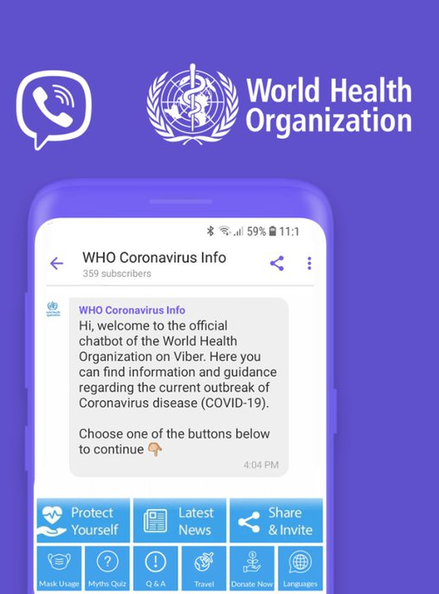
Chatbot with Rakuten Viber
Viber is a free messaging and calling app. Once subscribed to the WHO Viber chatbot, users will receive notifications with the latest news and information directly from WHO. Users can also learn how to protect themselves and test their knowledge on coronavirus through an interactive quiz that helps bust myths
WHO and @Viber fight #COVID19 misinformation with interactive chatbot in multiple languages

Slide 8
COVID-19 Online Courses
Real-time training during global emergencies is critical for effective preparedness and response.
The OpenWHO Massive Online Open Courses for COVID-19 provide learning resources for health professionals, decision-makers and the public. More than 320 000 learners have already enrolled.
As the pandemic continues to evolve, new resources will be added, additional language versions will continue to be rolled out, and existing courses will be updated to best reflect the changing context.
Courses include:
Operational Planning Guidelines to Support Country Preparedness and Response
Infection Prevention and Control
Acute Respiratory Infections (ARIs) and basic hygiene measures to protect against infection
Clinical Care Severe Acute Respiratory Infection
Emerging respiratory viruses, including COVID-19: methods for detection, prevention, response and control

Slide 9
Off-label use of medicines for COVID-19
No pharmaceutical products have yet been shown to be safe and effective for the treatment of COVID-19. However, a number of medicines have been suggested as potential investigational therapies, many of which are now being or will soon be studied in clinical trials, including the SOLIDARITY trial co-sponsored by WHO and participating countries

Slide 10
Mental health and COVID-19
WHO is providing guidance to help people manage fear, stigma and discrimination during COVID-19

Slide 12
Guidance for those at higher risk of infection
Use of Cloth Face Coverings to Help Slow the Spread of COVID-19
Should you get tested?
Caring for someone
Daily life & coping
Discontinuation of Home Isolation for Persons with COVID-19 (Interim Guidance)

Slide 13
Use of Cloth Face Coverings
CDC recommends wearing cloth face coverings in public settings where other social distancing measures are difficult to maintain (e.g., grocery stores and pharmacies), especially in areas of significant community-based transmission
CDC also advises the use of simple cloth face coverings to slow the spread of the virus and help people who may have the virus and do not know it from transmitting it to others. Cloth face coverings fashioned from household items or made at home from common materials at low cost can be used as an additional, voluntary public health measure
Cloth face coverings should not be placed on young children under age 2, anyone who has trouble breathing, or is unconscious, incapacitated or otherwise unable to remove the mask without assistance
The cloth face coverings recommended are not surgical masks or N-95 respirators. Those are critical supplies that must continue to be reserved for healthcare workers and other medical first responders, as recommended by current CDC guidance

Slide 14
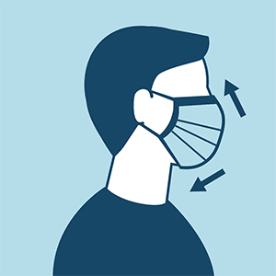
How to Wear a Cloth Face Covering
Cloth face coverings should:
Fit snugly but comfortably against the side of the face
Be secured with ties or ear loops
Include multiple layers of fabric
Allow for breathing without restriction
Be able to be laundered and machine dried without damage or change to shape

Slide 15
Homemade Cloth Face Coverings
Should cloth face coverings be washed or otherwise cleaned regularly? How regularly?
Yes. They should be routinely washed depending on the frequency of use.
How does one safely sterilize/clean a cloth face covering?
A washing machine should suffice in properly washing a face covering.
How does one safely remove a used cloth face covering?
Individuals should be careful not to touch their eyes, nose, and mouth when removing their face covering and wash hands immediately after removing.

Slide 16
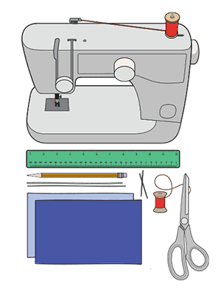
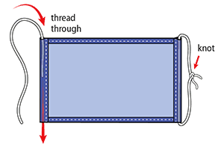
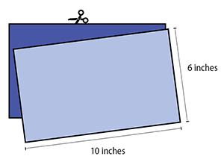
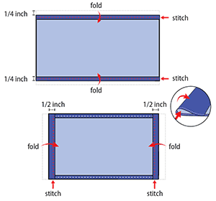
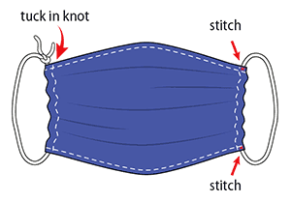
Cloth Face Covering Sample Instructions Sew Method
Cut out two 10-by-6-inch rectangles of cotton fabric. Use tightly woven cotton, such as quilting fabric or cotton sheets. T-shirt fabric will work in a pinch. Stack the two rectangles; you will sew the mask as if it was a single piece of fabric

Slide 17
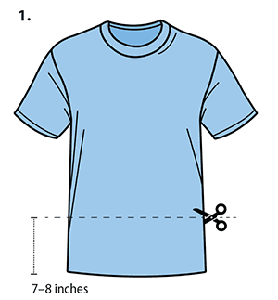
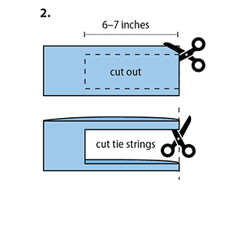
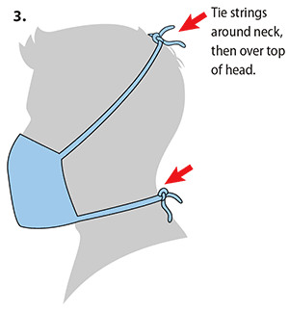
Cloth Face Covering Sample Instructions No Sew Method
Quick Cut T-shirt Face Covering

Slide 18
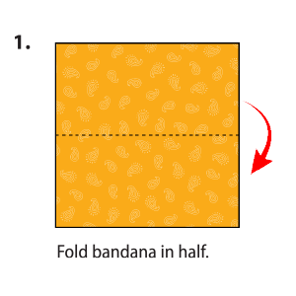
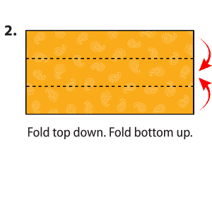
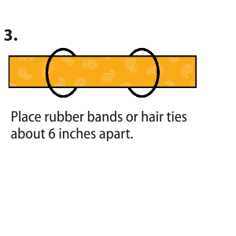
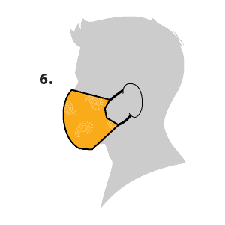
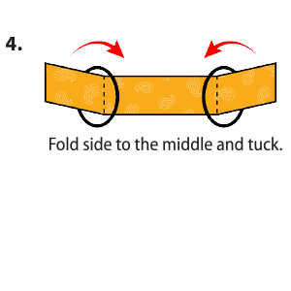
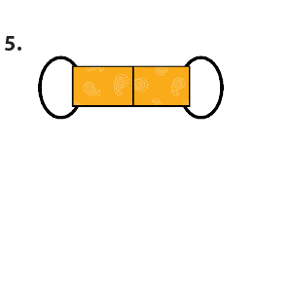
Cloth Face Covering Sample Instructions No Sew Method
Bandana Face Covering

Slide 19
CDC Guidelines on When to end home isolation (staying home)
People with COVID-19 who have stayed home (are home isolated) can stop home isolation under the following conditions:
If they will not have a test to determine if they are still contagious, they can leave home after these three things have happened:
They have had no fever for at least 72 hours (that is three full days of no fever without the use medicine that reduces fevers) AND
other symptoms have improved (for example, when their cough or shortness of breath have improved) AND
at least 7 days have passed since their symptoms first appeared
If they will be tested to determine if they are still contagious, they can leave home after these three things have happened:
They no longer have a fever (without the use medicine that reduces fevers) AND
other symptoms have improved (for example, when their cough or shortness of breath have improved) AND
They received two negative tests in a row, 24 hours apart. Their doctor will follow CDC guidelines.

Slide 20
CDC Recommends
Everyone can do their part to help us respond to this emerging public health threat:
CDC is recommending the use of a cloth face covering to keep people who are infected but do not have symptoms from spreading COVID-19 to others
The cloth face cover is meant to protect other people in case you are infected
The cloth face coverings recommended are not surgical masks or N-95 respirators. Medical face masks are critical supplies that should be reserved for healthcare workers and other first responders, as recommended by CDC
The cloth face cover is not a substitute for social distancing
CDC continues to recommend that people try keep about 6 feet between themselves and others

Slide 21
New CDC COVID-19 Guidelines
Slow the spread
Cloth face covers NEW
Critical workers NEW
Implementing Safety Practices for Critical Infrastructure Workers Who May Have Had Exposure to a Person with Suspected or Confirmed COVID-19

Slide 22
References
https://www.who.int/
https://www.cdc.gov/

